Slide 1



E-COMMERCE PLATFORM
AMANA
PRESENTATION
page 01
2025

Slide 2



Introduction
MARKET CHALLENGE: RISING POPULATION DENSITY AND LIMITED RETAIL SPACE ARE DRIVING UP SHOP RENTAL RATES
IMPACT ON SMES: SMALL AND MEDIUM-SIZED BUSINESS OWNERS FACE PROHIBITIVE COSTS FOR PHYSICAL STOREFRONTS, HINDERING START-UPS AND EXPANSION
ENTREPRENEURIAL BARRIER: HIGH OVERHEAD REDUCES OPPORTUNITIES FOR NEW VENTURES AND LIMITS CONSUMER CHOICE
OUR SOLUTION: “AMANA” – AN AMAZON-STYLE ONLINE MARKETPLACE THAT REMOVES THE NEED FOR PHYSICAL SHOPS
page 02

Slide 3
Introduction
KEY FEATURES:
SEAMLESS, USER-FRIENDLY WEB INTERFACE
SECURE, INTEGRATED PAYMENT PROCESSING
EFFICIENT LOGISTICS AND DELIVERY INTEGRATION
BROAD CUSTOMER REACH WITHOUT GEOGRAPHIC CONSTRAINTS
BUSINESS BENEFITS:
LOWER OPERATIONAL COSTS
FASTER MARKET ENTRY AND SCALABILITY
ENHANCED VISIBILITY AND SALES POTENTIAL FOR ENTREPRENEURS
CONSUMER ADVANTAGE:
WIDER PRODUCT SELECTION
CONVENIENT SHOPPING EXPERIENCE FROM ANY LOCATION
page 02

Slide 4
System
Architecture
page 03

Slide 5
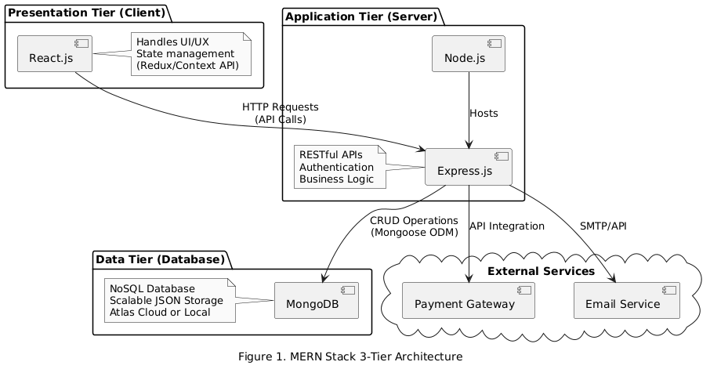
Architecture
style

Slide 6
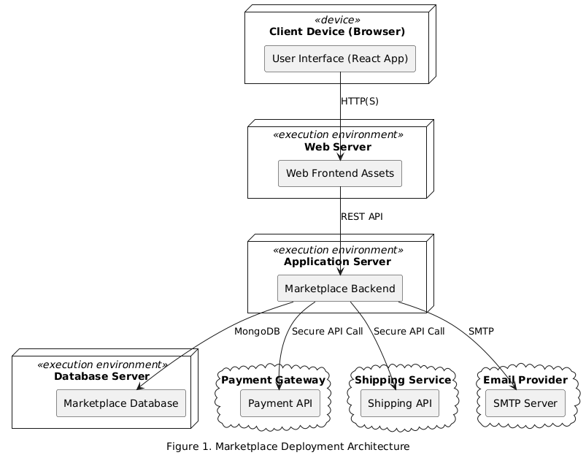
Deployment
Diagram
page 03

Slide 7
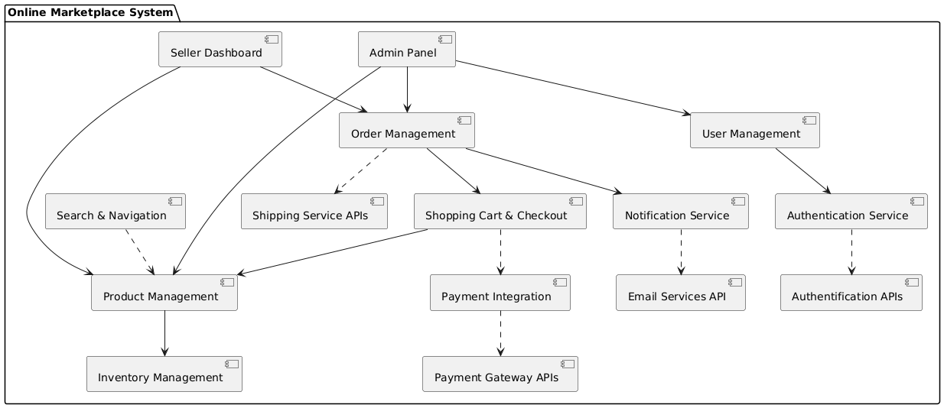
Component
Diagram
page 03

Slide 8
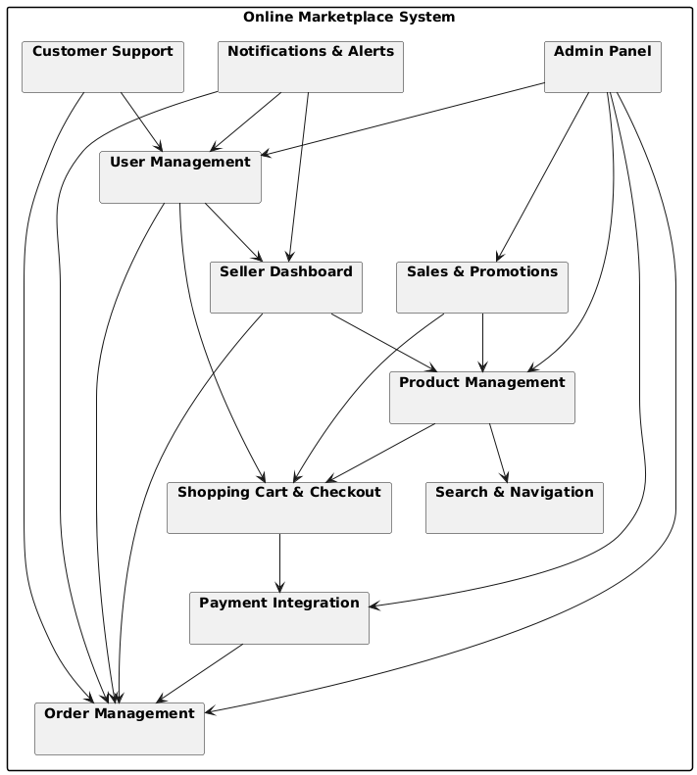
Package
Diagram
page 03

Slide 9
Project
Planner
page 03

Slide 10
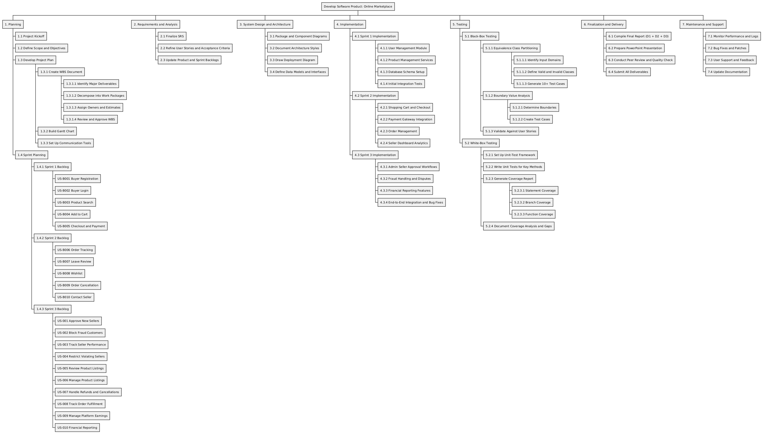
WBS
work-breakdown structure - snippet
page 03

Slide 11
WBS
work-breakdown structure - snippet
page 03

Slide 12
WBS
work-breakdown structure - snippet
page 03

Slide 13
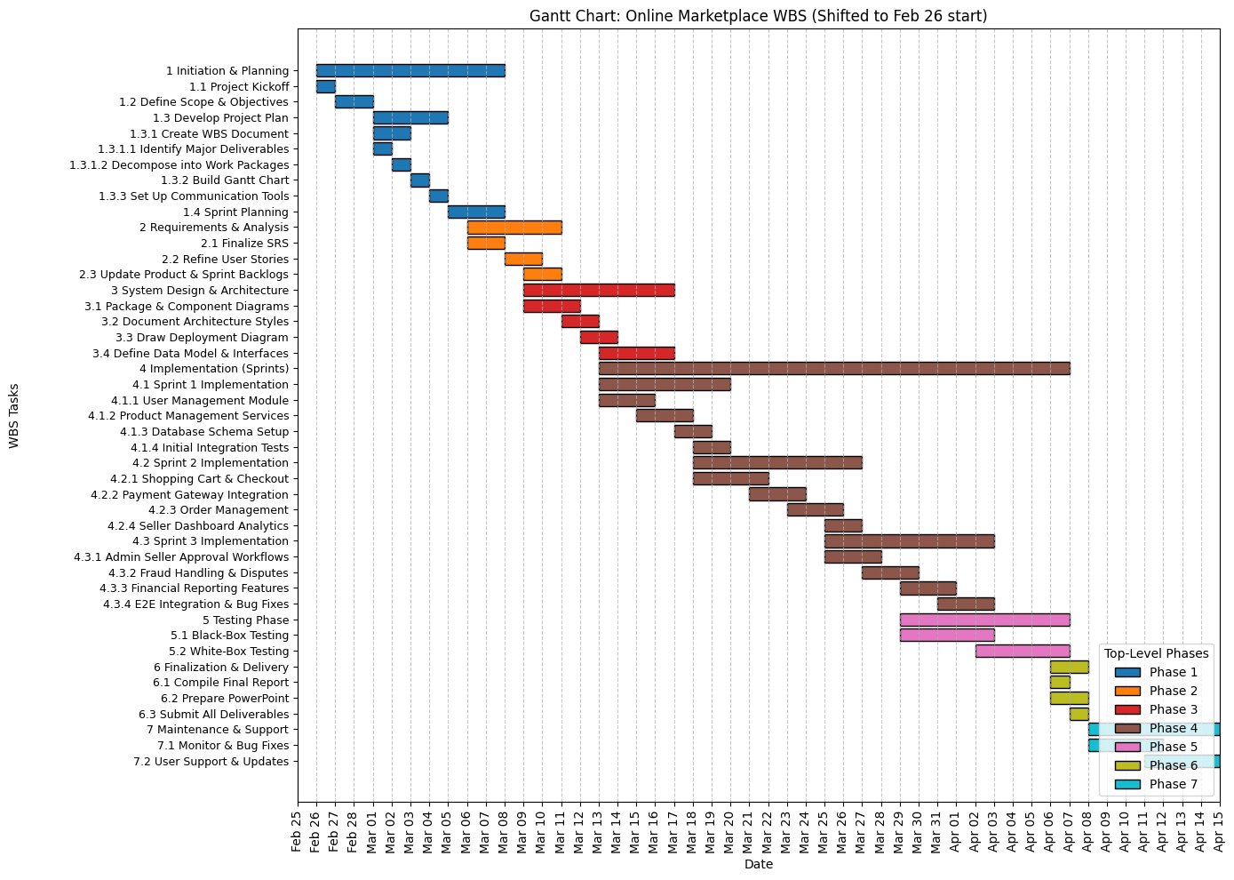
Gantt
Chart
page 03

Slide 14
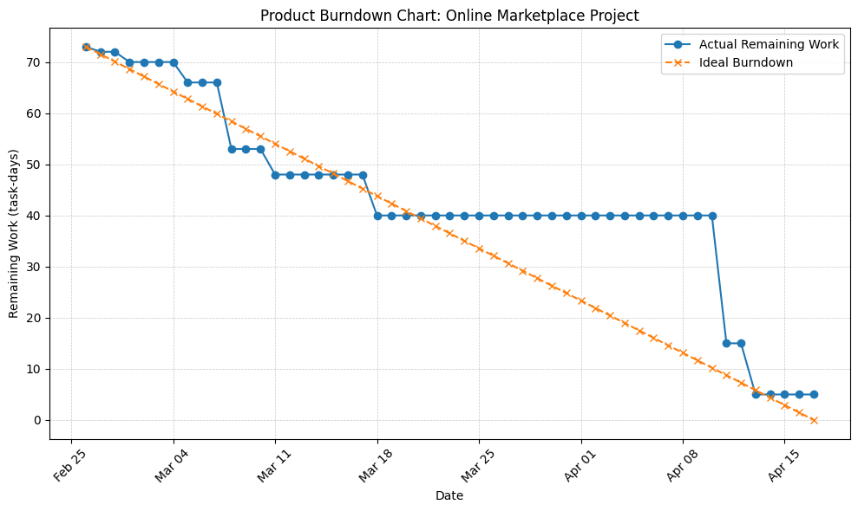
Product Burndown
chart
page 03

Slide 15
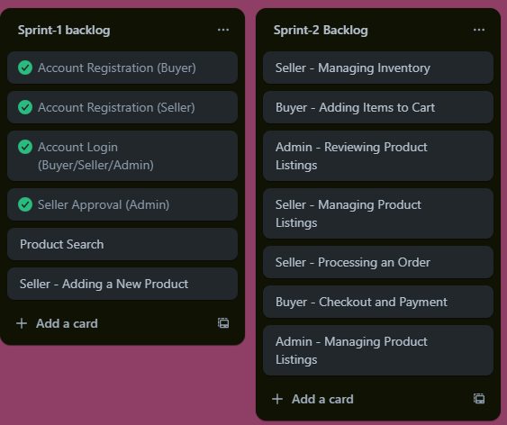
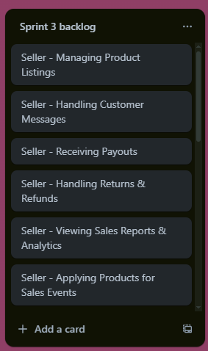
Sprint
Planning
page 03

Slide 16
User
Stories
page 03

Slide 17
Buyer
Story
page 03

Slide 18
User Story - As a buyer, I want to search for products by name, category, or filters So that I can quickly find what I need.
Story ID: US-B003
Story Title: Product Search
Acceptance Criteria - And I know I am done when:
Scenario: Searching for a product
Given the buyer is on the homepage
When they enter a product name in the search bar
Then the system displays relevant search results
Scenario: Using filters
Given the buyer is on the search page
When they apply filters (e.g., price range, brand, rating)
Then the system displays filtered results
page 03
Importance: High
Estimate: 5
Type: Search

Slide 19
Seller
Story
page 03

Slide 20
Story ID: US-016
Story Title: Adding New Product
User Story As a seller, I want to be able to add new products to my store So that customers can view and purchase them.
Acceptance Criteria
And I know I am done when:
Scenario: Successfully adding a product
Given the seller is logged in And they navigate to the "Add Product" page
When they enter valid product details and submit the form
Then the system adds the product to the store and displays a success message
Scenario: Attempting to add a product with missing details
Given the seller is on the "Add Product" page
When they leave a required field empty and submit the form
Then the system displays an error message specifying the missing details
page 03
Importance: High
Estimate: 8
Type: - Manage Data

Slide 21
Admin
Story
page 03

Slide 22
User Story - As an admin, I want to review and approve new sellers,
So that only genuine sellers can sell on the platform.
Story ID: US-001
Story Title: Approving New Sellers
Acceptance Criteria
And I know I am done when:
Scenario: Viewing pending seller applications
Given the admin is on the seller approval dashboard
When they access the list of pending applications
Then they can see seller details and uploaded documents
Scenario: Approving a seller
Given a seller has submitted a valid application
When the admin verifies the documents and business details
Then they can approve the seller’s account
And the seller receives a confirmation email
page 03
Importance: High
Estimate: 5
Type: Manage Data

Slide 23
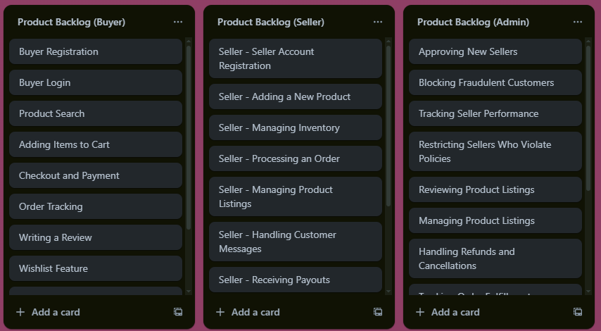
Product
Backlog
page 03

Slide 24
Black Box
Testing
page 03

Slide 25
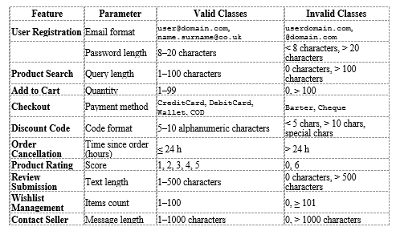
page 03

Slide 26
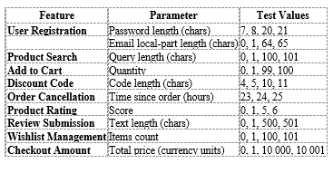
page 03

Slide 27
White Box
Testing
page 03

Slide 28
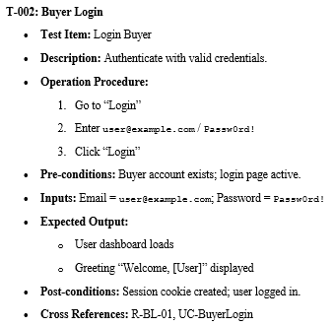
page 03

Slide 29
Further
Improvements
Integrate AI-driven product recommendations and personalized shopping experience
Launch mobile apps for Android and iOS for broader accessibility
Partner with more courier services for faster, real-time delivery tracking
Add multi-language support and expand regionally to reach underserved markets
Introduce subscription plans and promotional tools for sellers to enhance visibility and revenue
page 03

Slide 30
Conclusion
“Amana” successfully addresses key challenges faced by SMEs by providing a cost-effective digital marketplace
Enables businesses to operate without physical stores, reducing barriers to entry and operational expenses
Offers a scalable and secure platform for buyers and sellers with streamlined logistics and user-friendly design
page 03

Slide 31

Our
Team
Muhammad Khan
Muhammad Ahmed Mufti
Syed Hussain Waseem
page 05
i22-1040
Product Owner
i22-1088
Developer
i22-0893
Scrum Master

Slide 32
THANK YOU!
MORE INFORMATION: WWW.AMANA.COM
page 15

